Slide 1
Breast Cancer Prediction Using AI and ML

Slide 2
PROJECT OUTLINE
Project Details
Project Description
Project Objectives
Methodology
Implementation

Slide 3
Project Details
Project Name: Breast Cancer Prediction using AL and ML
Project Leader: Gulzhan Isaeva 12194812
Project Manager: Kunishev Ozodjon 12190259
Other Participants: Ibragimov Jasurbek 12190263 Ibrokhimov Muslimjon Mukhtorjon ugli 12194836 Makhammadjonov Izzatullokh Khayrullo ugli 12194921

Slide 4
Project Description
Breast cancer is the most common diagnosed cancer for women as well as men in middle ages
It is difficult to predict and diagnose in early stages (no symptoms)
More than 1.15 million cases of breast cancer diagnosed globally every year
Early detection of this fatal disease is extremely important which helps in decreasing the morality rate and increasing the survival period of breast cancer patients
https://www.who.int/news-room/fact-sheets/detail/breast-cancer

Slide 5
Project Objectives
Out of 1.15 million people diagnosed with breast cancer 685,000 (59.5%) people died in a year of 2020.
Aim of this Project is to detect or predict breast cancer in its early stages to increase the chances of curing and decrease the number of deaths.
https://acsjournals.onlinelibrary.wiley.com/doi/10.3322/caac.21754

Slide 6
Breast Cancer Wisconsin (Diagnostic) Data Set
About Dataset:
Features are computed from a digitized image of a fine needle aspirate (FNA) of a breast mass. They describe characteristics of the cell nuclei present in the image.
Attribute Information:
1) ID number 2) Diagnosis (M = malignant, B = benign)

Slide 7
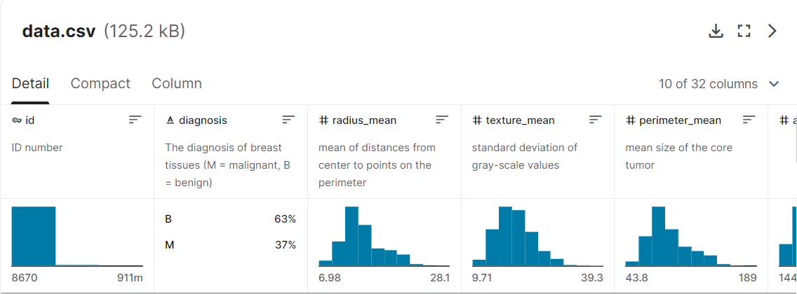
https://www.kaggle.com/code/dhainjeamita/breast-cancer-dataset-classification/notebook

Slide 8
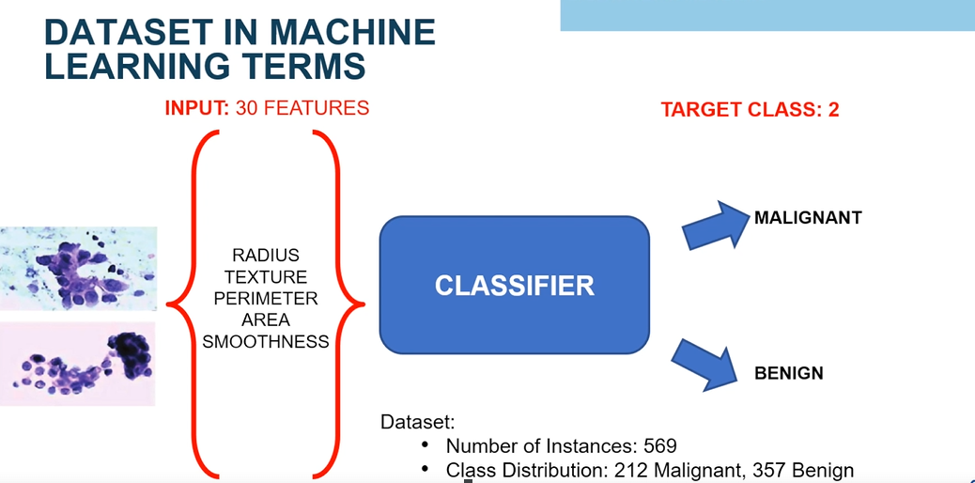
Methodology

Slide 9
Methodology
Predicting if the cancer diagnosis is benign or malignant based on several observations/features
Malignant has cancer cells while Benign has no cancer cells
30 features are used to make predictions
Number of Instances: 569
Class Distribution: 212 Malignant, 357 Benign
Target class: - Malignant - Benign

Slide 10
Ten real-valued features are computed for each cell nucleus:
a) radius (mean of distances from center to points on the perimeter) b) texture (standard deviation of gray-scale values) c) perimeter d) area e) smoothness (local variation in radius lengths) f) compactness (perimeter^2 / area - 1.0) g) concavity (severity of concave portions of the contour) h) concave points (number of concave portions of the contour) i) symmetry j) fractal dimension ("coastline approximation" - 1)

Slide 11
Project Implementation
GitHub Link of the Project:
https://github.com/GulzhanIsaeva/AI_Part2_12194812/blob/081e1199dc06b55ed90b67470dc6db6063e537da/Project1_Breast_Cancer_Prediction.ipynb

Slide 12

Project Implementation
Features are computed from a digitized image of a fine needle aspirate (FNA) of a breast mass. They describe characteristics of the cell nuclei present in the image.

Slide 13

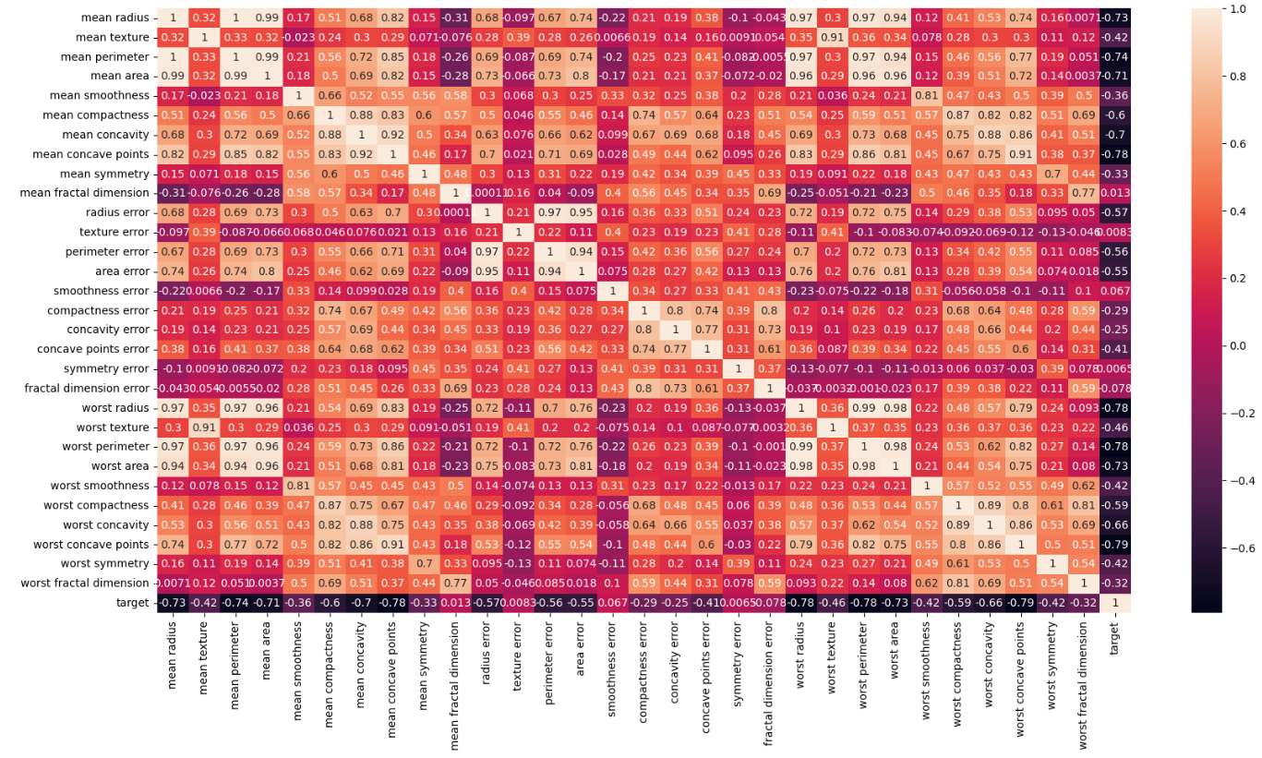

Slide 14
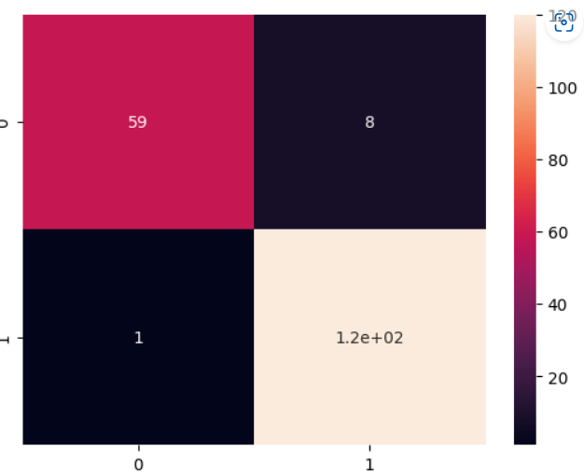
Challenges & Solutions
Actual data
T
F
T
Predicted
model
F

Slide 15
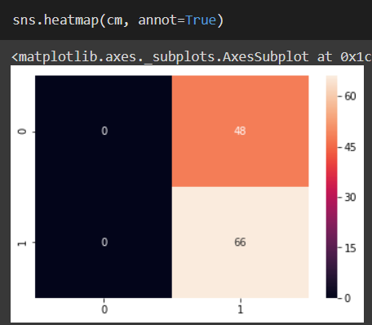
Challenges & Solutions
Actual data
T
F
T
Predicted
model
F

Slide 16
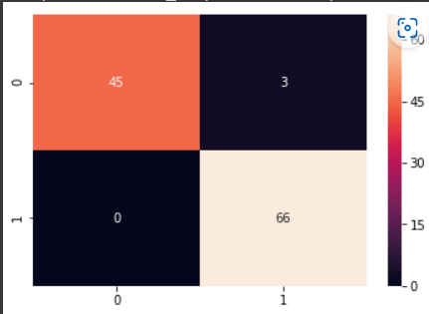
Challenges & Solutions
Actual data
T
F
T
Predicted
model
F

Slide 17
The Reason why the merged Dataset work well:
- the algorithm that used for skit-learn library dataset was very good
- Kaggle dataset values were more accurate

Slide 18
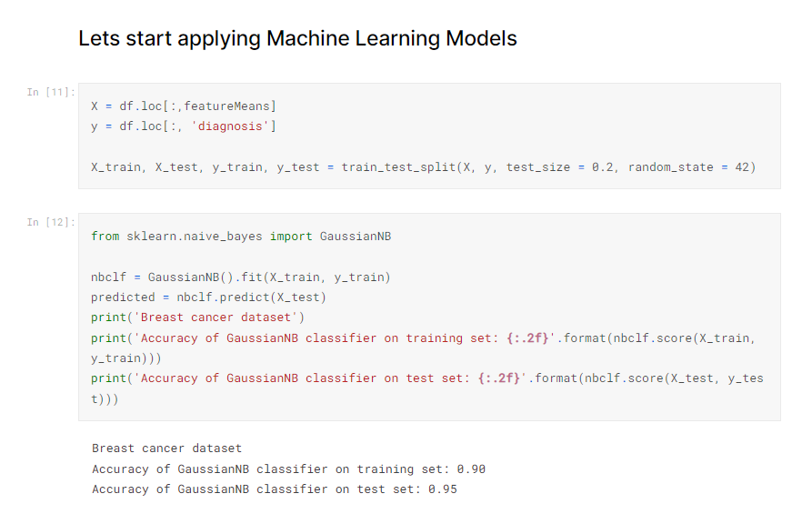
Accuracy

Slide 19
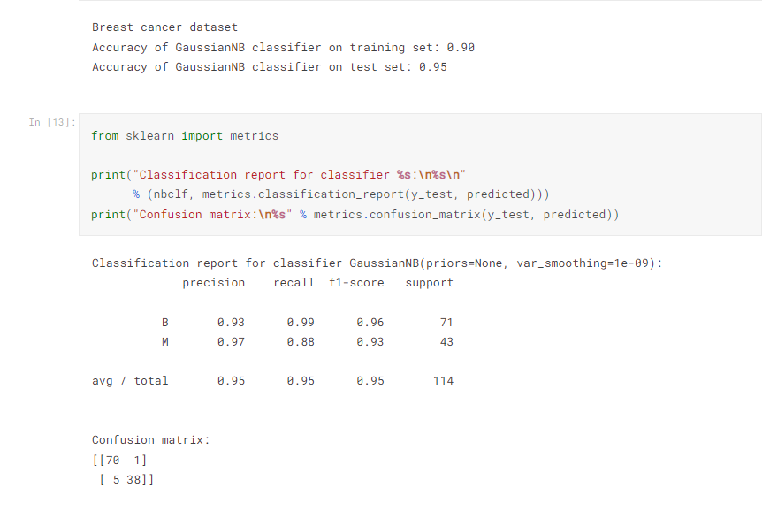
Accuracy

Slide 20
References
sklearn.datasets.load_breast_cancer — scikit-learn 1.1.3 documentation
Breast Cancer Dataset Classification | Kaggle
https://archive.ics.uci.edu/ml/datasets/Breast+Cancer+Wisconsin+%28Diagnostic%29
https://www.kaggle.com/code/dhainjeamita/breast-cancer-dataset-classification/notebook
https://www.kaggle.com/datasets/uciml/breast-cancer-wisconsin-data?titleType=dataset-downloads&showDatasetDownloadSkip=False&messageId=datasetsWelcome&returnUrl=%2Fdatasets%2Fuciml%2Fbreast-cancer-wisconsin-data%2Fversions%2F2%3Fresource%3Ddownload

